Slide 1
Particle swarm optimization
Find the best minimum value of f(x,y) with the appropriate pair of x,y
Tzagkarakis kostas, mp141
Trivizakis eleftherios, mp143

Slide 2
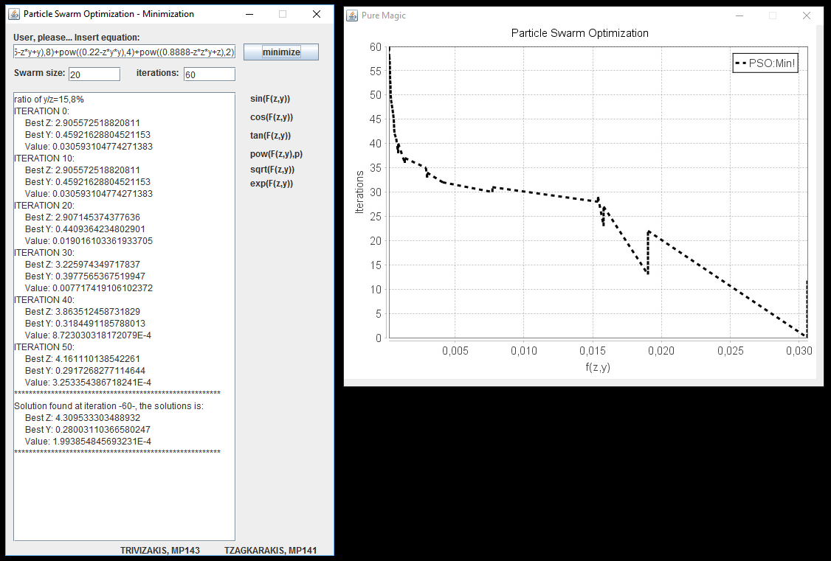
TOOLS & DEVELOPMENT
ECLIPSE IDE
JDK
CODE WRITTEN IN JAVA
GUI → USER INTERACTION
Libraries
JEval
JFreeChart

Slide 3
How algorithm works?

Slide 4
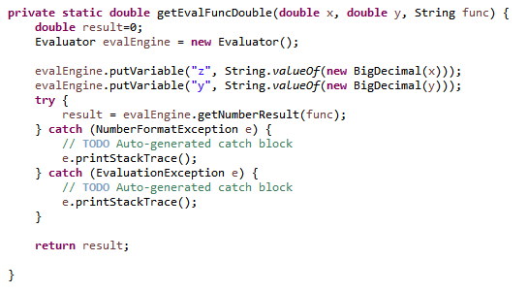
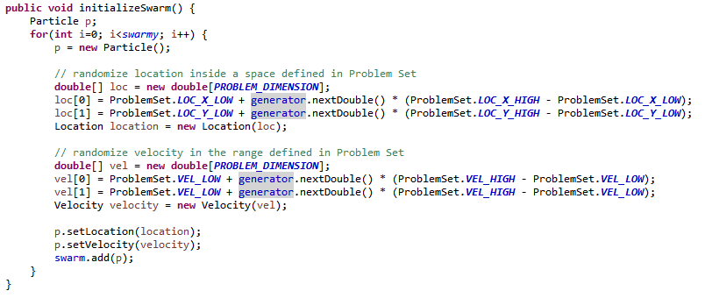

INITIALIZE SWARM
INITIALIZE SWARM
BY RANDOMLY CREATING PARTICLES
ALWAYS TEST AGAINST BOUNDARIES
KEEPS PARTICLES IN CONSTRAIN
EVALUATE THE NEW PARTICLES AGAINST THE FUNCTION
UPDATE FITNESS
THE VALUE OF F(X,Y) PER PARTICLE
UPDATE FITNESS LIST
GET VALUES FROM PARTICLES

Slide 5
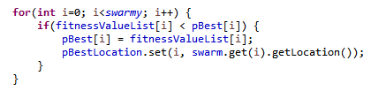

FIND THE MINIMUM VALUE
WE HAVE THE VALUES IN FITNESS LIST
FIND THE LOWEST VALUES
CREATE A NEW BEST FITNESS LIST
GIVES THE BEST SWARM LOCATION

Slide 6
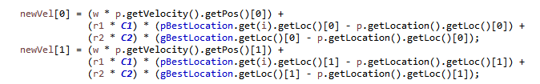

RECALCULATE VELOCITY + POSITION
CALCULATE VELOCITY → COMBINING
FIND THE BEST SWARM’S POSITION
FIND THE BEST PERSONAL POSITION
RANDOMNESS
BOUNDRIES
GET NEW POSITION → COMBINING
CURRENT POSSITION
NEW VELOCITY

Slide 7
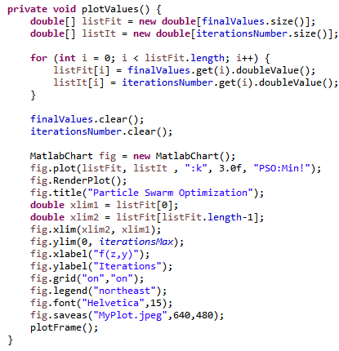
REVALUATE - ITERATIONS
CALCULATE NEW FITNESS
CALCULATE NEW VELOCITIES
CALCULATE NEW POSITIONS
UNTIL MAX ITERATIONS or ERR=1E-20
PLOT THE VALUES

Slide 8
DATA

Slide 9
Definition of problem
USER GIVES FUNCTION F(X,Y)
TRY TO FIND AN X AND Y
THAT MINIMIZE THE GIVEN FUNCTION
IN A BOUNDED 2-DIMENSIONAL SPACE
LIMITED ITERATIONS

Slide 10
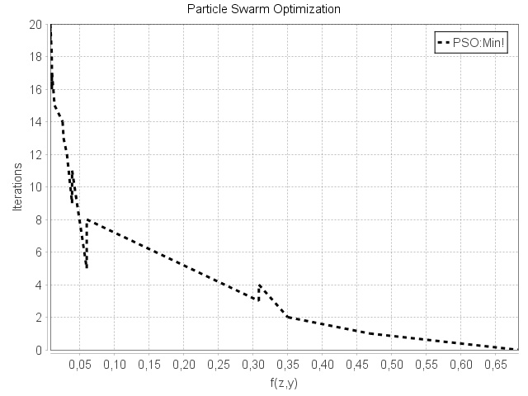
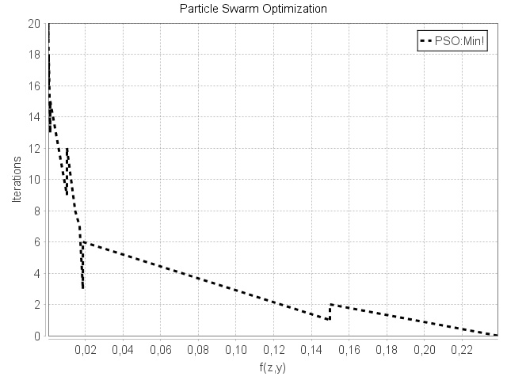
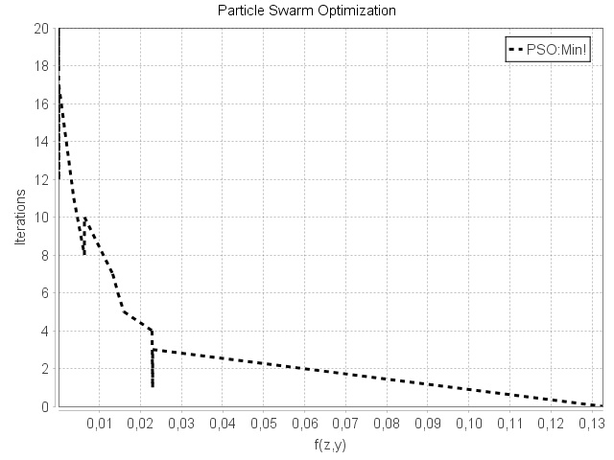
EXPERIMENT AND DATA
_{iterations} ^{swarm size} | 20 | 40 | 60
20 | 7,7E-03 | 4,0E-04 | 4,0E-05
50 | 6,0E-04 | 1,0E-05 | 1,8E-06
80 | 5,5E-04 | 1,4E-05 | 2,3E-06
120 | 8,0E-06 | 1,0E-07 | 7,4E-09
f(z,y) = (0.9455-z*y+y)⁸+(0.22-z*y*y)⁴ + (0.8888-z*z*y+z)²
^{ITERATIONS → 20}

Slide 11
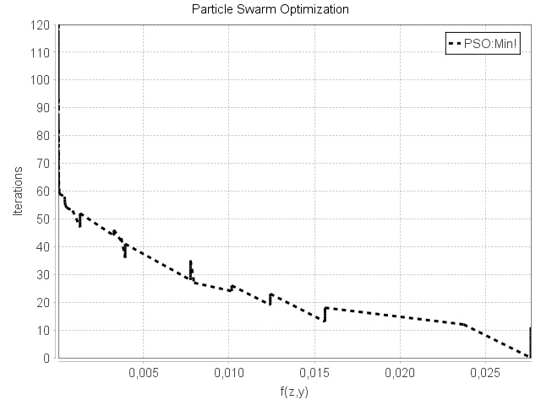
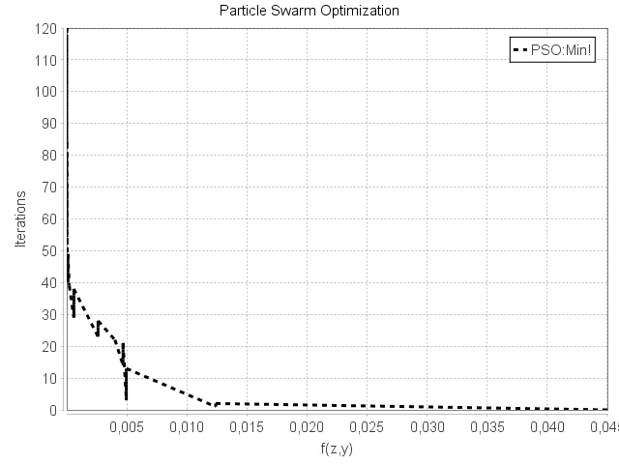
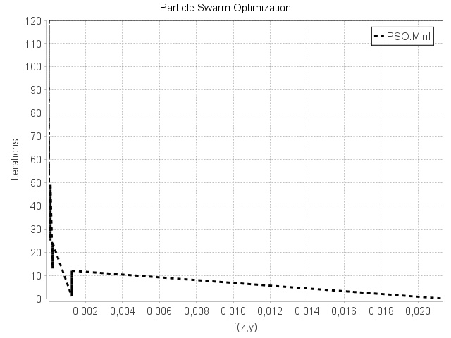
EXPERIMENT AND DATA
_{iterations} ^{swarm size} | 20 | 40 | 60
20 | 7,7E-03 | 4,0E-04 | 4,0E-05
50 | 6,0E-04 | 1,0E-05 | 1,8E-06
80 | 5,5E-04 | 1,4E-05 | 2,3E-06
120 | 8,0E-06 | 1,0E-07 | 7,4E-09
f(z,y) = (0.9455-z*y+y)⁸+(0.22-z*y*y)⁴ + (0.8888-z*z*y+z)²
ITERATIONS →120

Slide 12
PSO CONVERGENCE - WEAKNESS
PARTICLES TEND TO
TRAP IN A PERSONAL OPTIMAL VALUE
IN EXTEND
SWARM IS TRAPPED TOO
GLOBAL BEST LOCATION
NOT ENOUGH
SOLUTION
orthogonal learning strategy

Slide 13
References
[1] | J. Kennedy and R. Eberhart, "Particle swarm optimization," in Proceedings of IEEE International, Piscataway, NJ, 1995.
[2] | M. Clerc and J. Kennedy, "The particle swarm-explosion, stability and convergence in a multidimensional," in IEEE Transactions on Evolutionary Computation, 2002.
[3] | Y. Shi and R. C. Eberhart, "A modified particle swarm optimizer," in Proceedings of IEEE International, 1998.
[4] | F. Van den Bergh, "A convergence proof for the particle swarm optimiser," in Fundamenta 34. Informaticae.
[5] | A. P. Engelbrecht, Fundamentals of Computational Swarm Intelligence, Chichester, UK: John Wiley & Sons, 2005.
[6] | breidecker, "JEval," [Online]. Available: http://jeval.sourceforge.net/. [Accessed 29 10 2016].
[7] | mungady and taqua, "JFreeChart," [Online]. Available: https://sourceforge.net/projects/jfreechart. [Accessed 29 10 2016].
[8] | Z. Zheng and S. Yuhui, "Inertia Weight Adaption in Particle Swarm Optimization Algorithm," in Advances in Swarm Intelligence, Chongqing, Springer Berlin Heidelberg, 2011, pp. 71-79.
[9] | M. r. Bonyadi and Z. Michalewicz, "A locally convergent rotationally invariant particle swarm optimization algorithm," in Swarm intelligence, 2014, p. 159–198.
[10] | Z. H. Zhan, J. Zhang, Y. Li and Y. H. Shi, "Orthogonal Learning Particle Swarm Optimization," in IEEE Transactions on Evolutionary Computation, 2011.

Slide 14
THANKS!

